Slide 1
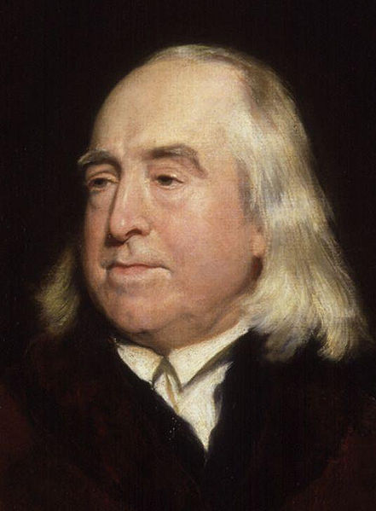
Jeremy Bentham
15 February 1748 – 6 June 1832

Slide 2
Jeremy Bentham
(15 February 1748 – 6 June 1832)
Jeremy Bentham was an English jurist, philosopher, and legal and social reformer.
He became a leading theorist in Anglo-American philosophy of law, and a political radical whose ideas influenced the development of welfarism.
He is best known for his advocacy of utilitarianism
and animal rights, and the idea of the Panopticon.

Slide 3
Utilitarianism by Jeremy Bentham

Slide 4
Utilitarianism by Jeremy Bentham
Bentham's ambition in life was to create a "Pannomion", a complete utilitarian code of law.
As a social reformer, Bentham applied this principle to the laws of England
  for example, those areas of the law concerning crime and punishment. An analysis of theft reveals that it not only causes harm to the victim, but, if left unpunished, it endangers the very status of private property and the stability of society.
This utilitarianism philosophy argued that the right act or policy was that which would cause "the greatest good for the greatest number of people", also known as "the greatest happiness principle", or the principle of utility.
He also suggested a procedure for estimating the moral status of any action, which he called the Hedonistic or felicific calculus.

Slide 5
Felicific calculus
The felicific calculus is an algorithm formulated by utilitarian philosopher Jeremy Bentham for calculating the degree or amount of pleasure that a specific action is likely to cause.
Bentham, an ethical hedonist, believed the moral rightness or wrongness of an action to be a function of the amount of pleasure or pain that it produced.
The felicific calculus could, in principle at least, determine the moral status of any considered act.
The algorithm is also known as the utility calculus, the hedonistic calculus and the hedonic calculus.

Slide 6
The Hedonic Calculus
Hedonic calculus: measure the rightness of an action by these features:
Intensity = a more intense pleasure is preferable to a weaker pleasure.
Duration = pleasures that last are preferable to those that don’t.
Certainty = if the act guarantees a pleasure, that act is better than one that merely makes pleasure likely.
Propinquity = if the pleasure is far off in space or time, the act is less right.
Fecundity = the likelihood that the pleasure or pain will be followed by more pleasures or pains.
Purity = a pleasure that is mixed with pain is not as good as one that just pleasure.
Extent = the more people who will enjoy the pleasure, the better the act.

